Slide 1
Outline
What is Git and version control?
How to download Git?
Setting up Git
Creating a Repo
How does Git work?
Git Unstage files and Tracking Changes
Committing a folder, Deleting, Ignore
Git Branch, Merges & Conflicts
Remotes in CERN Gitlab
Gitlab CI

Slide 2
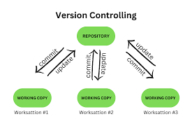
WHAT IS VERSION CONTROL
Version control is the practice of tracking and managing changes to files over time, often used in software development to manage source code. It allows multiple people to collaborate on a project by recording every modification, so team members can see who made a change, when, and can revert to a previous version if necessary. Version control systems (VCS) provide a safety net against accidental loss of data and streamline workflows, especially for complex projects

Slide 3

What is Git/GitLab/GitHub?
Git: Version Control System.
GitLab/GitHub: Source Code management System/platform used to host git repositories and to share it with others enabling collaboration.
GitLab has a built-in CI/CD whereas GitHub doesn’t.

Slide 4
Download Git
📚 - Resources
Git installation instructions
Setup Git for Windows 10
Setup Git for macOS
Setup Git for Linux

Slide 5
Setting up Git
git --version
git config --global user.name “Sherlock Holmes”
git config --global user.email “Imsherlocked@gmail.com”
git config -h (list of commands)
git config --help (git manual)

Slide 6
Creating a Repository
mkdir gitlab (make a directory - repository)
cd gitlab
git init (to initialise git)
git status (to show on which branch are you)
git add . (sends file to staging area)
git commit -m “my initial commit” (sends file to local repo)

Slide 7
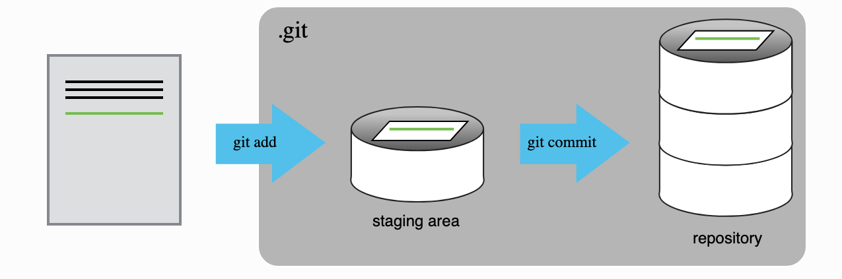
How does Git work?

Slide 8
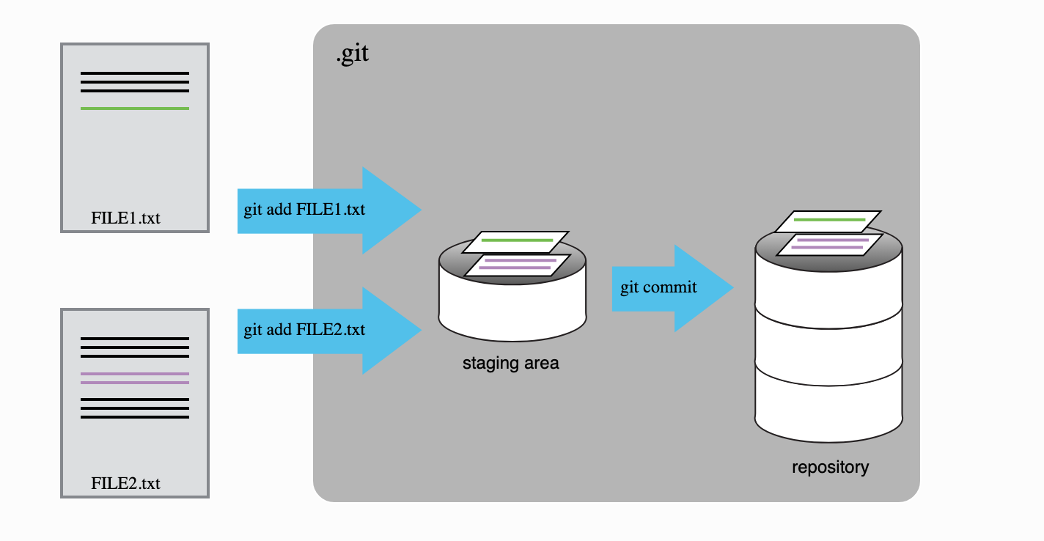
How does Git work?

Slide 9
Git Unstage files
vim index.html
vim readme.md (”Hello! I am learning git”)
git status
git add .
git commit -m “Added index.html and readme”
git status
git reset HEAD readme.md (Note: Removes from the staging area and it doesn’t mean that the changes have gone away. Need to commit)
git status
git commit -m “added first page” (Commits only index.html)
git status
git add .
git commit -m “added readme”
git status

Slide 10
Track Changes
git status
git log (shows the time and date of each commit)
git log --patch (shows the details of the file)
git diff (helps to review changes)
git diff --staged (Press q to quit)

Slide 11
Committing a folder
mkdir temp
ls -a
git status
touch temp/.gitkeep (Create an empty file inside an empty folder)
git status
git add .
git commit -m “Added a temp folder”
git status

Slide 12
Delete Files
touch newfile.txt
ls -a
git status
rm newfile.txt
git status
Question: Will it be removed?

Slide 13
Delete Folder
rm -rf -- temp
ls -a
git status
git add .
git commit -m “removed file and folder”

Slide 14
Ignore files (For private files not in repo)
mkdir config
touch config/private.txt
git status
vim .gitignore (config/ - specify files and folders you want to ignore)
git status
ls -a
git add .
git commit -m “Added gitignore config”
git status

Slide 15
Git Branch
git checkout -b feature/new-table
git status
vim index.html (Make some changes in the branch feature/new-table)
git add .
git commit -m “Added a table”
cat index.html
git checkout master
cat index.html
git checkout feature/new-table
git branch -d feature/new-table

Slide 16
Git Merge
1. Fast-forward merge
git checkout master
git merge feature/new-table
git log
git branch
git branch -d feature/new-table

Slide 17
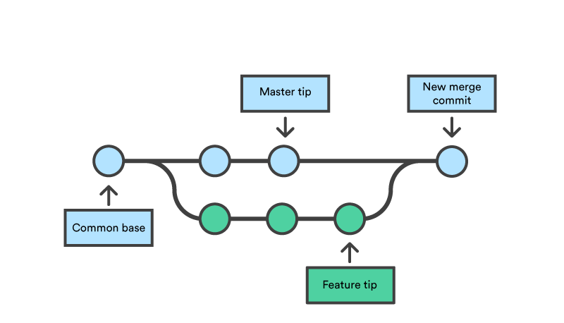
Fast-forward Merge

Slide 18
Git Merge
2. Advance merge
git checkout -b bugfix/table
vim index.html
git add .
git status
git commit -m “Added table cell”
git checkout master
vim readme.md (I am learning and merging)
git add .
git commit -m “Learning branching”

Slide 19
Git Merge
2. Advance merge - continue… (Rebase Commits)
git checkout -b bugfix/table-2
vim index.html
git add .
git commit -m “Added 2nd cell”
git checkout master
vim readme.md (“I am learning, merging and rebasing”)
git add .
git commit -m “Learning rebasing”
git checkout bugfix/table-2
git log
git rebase master
git log
git checkout master
git merge bugfix/table-2

Slide 20
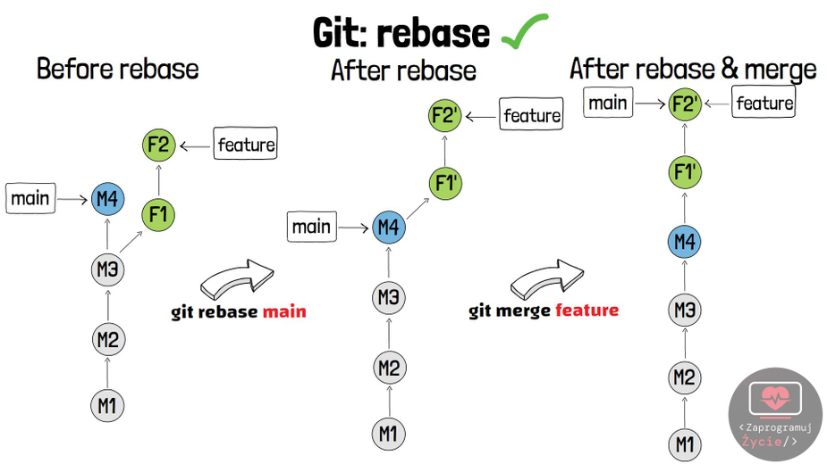
Advanced Merge

Slide 21
Merge Conflicts
git merge --abort
git rebase --abort
Go to the IDE (code .) and accept the changes
Then merge
git checkout master
git merge branch2

Slide 22
Remotes in CERN Gitlab- SSH
Generate an SSH key pair:
For example, for ED25519:
1. ssh-keygen -t ed25519 -C "<comment>"
For 2048-bit RSA:
2. ssh-keygen -t rsa -b 2048 -C "<comment>"
Generating public/private ed25519 key pair.
Enter file in which to save the key (/home/user/.ssh/id_ed25519):

Slide 23
Remotes in CERN Gitlab- SSH
Copy the contents of your public key file. You can do this manually or use a script. For example, to copy an ED25519 key to the clipboard:
macOS
tr -d '\n' < ~/.ssh/id_ed25519.pub | pbcopy
Linux (requires the xclip package)
xclip -sel clip < ~/.ssh/id_ed25519.pub
Git Bash on Windows
cat ~/.ssh/id_ed25519.pub | clip
Replace id_ed25519.pub with your filename. For example, use id_rsa.pub for RSA.
Sign in to GitLab.
On the top bar, in the top right corner, select your avatar.
Select Preferences.
On the left sidebar, select SSH Keys.
In the Key box, paste the contents of your public key. If you manually copied the key, make sure you copy the entire key, which starts with ssh-rsa, ssh-dss, ecdsa-sha2-nistp256, ecdsa-sha2-nistp384, ecdsa-sha2-nistp521, ssh-ed25519, sk-ecdsa-sha2-nistp256@openssh.com, or sk-ssh-ed25519@openssh.com, and may end with a comment.
In the Title box, type a description, like Work Laptop or Home Workstation.
Optional. Update Expiration date to modify the default expiration date. In:
GitLab 13.12 and earlier, the expiration date is informational only. It doesn’t prevent you from using the key. Administrators can view expiration dates and use them for guidance when deleting keys.
GitLab checks all SSH keys at 02:00 AM UTC every day. It emails an expiration notice for all SSH keys that expire on the current date. (Introduced in GitLab 13.11.)
GitLab checks all SSH keys at 01:00 AM UTC every day. It emails an expiration notice for all SSH keys that are scheduled to expire seven days from now. (Introduced in GitLab 13.11.)
Select Add key.

Slide 24
Remotes in CERN Gitlab- SSH
If this is the first time you connect, you should verify the authenticity of the GitLab host. If you see a message like:
The authenticity of host 'gitlab.example.com (35.231.145.151)' can't be established.
ECDSA key fingerprint is SHA256:HbW3g8zUjNSksFbqTiUWPWg2Bq1x8xdGUrliXFzSnUw.
Are you sure you want to continue connecting (yes/no)? yes
Warning: Permanently added 'gitlab.example.com' (ECDSA) to the list of known hosts.
Type yes and press Enter.
Run the ssh -T git@gitlab.cern.ch command again. You should receive a
Welcome to GitLab, @username! message. Everything is working correctly if the output of the command is:
Welcome to GitLab, @sherlock!

Slide 25
Remotes in CERN Gitlab- SSH
If the welcome message doesn’t appear, you can troubleshoot by running ssh in verbose mode:
ssh -Tvvv git@gitlab.example.com

Slide 26
Remotes in CERN Gitlab- Git Push
git remote add origin ssh://git@gitlab.cern.ch:7999/ssheth/my-cool-web.git
git add .
git commit -m ”Final commit"
git push -u origin master

Slide 27
Remotes in CERN Gitlab- Git Pull
git clone ssh://git@gitlab.cern.ch:7999/ssheth/my-cool-web.git
git pull origin master
vim pluto.txt
cat pluto.txt
git add .
git commit -m ”commit-2"
git push -u origin master

Slide 28
Remotes in CERN Gitlab- Git Clone
mkdir test_merge_requests/
cd test_merge_requests/
git clone ssh://git@gitlab.cern.ch:7999/starter-kit-scratch/starter-kit-example.git
cd starter-kit-example/
git remote add YOUR_CERN_USERNAME ssh://git@gitlab.cern.ch:7999/YOUR_CERN_USERNAME/starter-kit-example.git
git pull / git pull origin

Slide 29
Remotes in CERN Gitlab- Git Clone
In some cases you might end up with your working directory (and/or branch) “messed up” and the git pull command will not work seamlessly. If you are sure you are not going to lose anything important, you can simply reset your current working directory by ignoring any local modification and destroying it:
git fetch --all # make local git aware of what changed remotely
git reset --hard origin/master # lose any local modification
git clean -fxd # get rid of any extra files not under version control
You should be very careful about using the git reset and git clean commands, but they are very useful when your working area got messed up somehow.
echo "I hereby certify that this information is true." >> YOUR_CERN_USERNAME.txt
git commit -a -m 'Add information certification’
git push YOUR_CERN_USERNAME

Slide 30
Summary
A local Git repository can be connected to one or more remote repositories.
Use the SSH protocol to connect to remote repositories.
git push copies changes from a local repository to a remote repository.
git pull copies changes from a remote repository to a local repository. In practice, it is good to be sure that you have an updated version of the repository you are collaborating on, so you should git pull before making our changes. The basic collaborative workflow would be:
update your local repo with git pull origin master,
make your changes and stage them with git add,
commit your changes with git commit -m, and
upload the changes to GitLab with git push origin master

Slide 31
GitLab CI
Continuous integration (or CI) is a popular development practice where one or more tasks are ran automatically, often each time a commit is pushed to a remote repository.
Used for Running tests for software packages or deploying changes.
The .gitlab-ci.yml file is used to configure CI.
“Pipeline failed" means you can not merge because GitLab CI test has failed (https://gitlab.cern.ch/lhcb/Alignment/-/pipelines).
Practice: https://hsf-training.github.io/analysis-essentials/git/11-ci.html

Slide 32
Thanks for your attention

